Slide 1




PYTHON
REINFORCEMENT PROJECT
NYC RESTAURANT INSPECTION RESULTS
Presented by : M.Pavithra
Course : DADS
Date : 25-09-2025

Slide 2
Introduction
The NYC dataset contains detailed information about food establishments, their inspections, and geographic attributes. It includes variables such as inspection SCORE, GRADE, establishment identifiers (CAMIS, BIN, BBL), and location details (ZIPCODE, Latitude, Longitude, Street, Community Board, Council District, Census Tract, NTA). This dataset enables analysis of food safety compliance across different neighborhoods, identification of geographic patterns, and exploration of governance-related impacts on inspection outcomes.
Project Overview
Analyze food inspection scores and grades.
Study the impact of location factors on results.
Find geographic and trend patterns.
Clean data for accurate analysis.
Provide insights to support better decisions.

Slide 3
Problem Statement
Food safety is a critical public health concern in New York City, where thousands of establishments are inspected regularly. However, inspection outcomes vary across locations, and patterns influencing scores and grades are not always clear. Without proper analysis, it becomes difficult to identify key risk factors, geographic trends, and data quality issues. This project addresses these challenges by analyzing inspection data to uncover insights that can improve monitoring and decision-making.
Objective
To study NYC food inspection scores and grades.
To understand the effect of location factors on outcomes.
To clean and transform data to enhance quality and accuracy for analysis.
To apply statistical hypothesis testing to validate observed patterns and relationships.
To identify geographic and trend patterns through EDA.
To provide insights for better food safety decisions.

Slide 4
Data Understanding
The dataset used is The DOHMH New York City Restaurant Inspection Results .Data Understanding involves exploring the NYC food inspection dataset to get familiar with its structure, variables, and contents.
Imported all required libraries.
Loaded ‘NYC_Restaurant.csv’ into pandas Data Frame and previewed.
Dataset Overview :
Rows : 290022
Columns : 27
Key Variables :
1. Inspection Outcome Variables : SCORE GRADE
2. Location Variables : Community Board Council District Latitude & Longitude ZIPCODE Street, Census Tract, BIN, BBL, NTA
3. Establishment Identifiers & Contact : CAMIS PHONE

Slide 5
Data Cleaning
Dropped features that have more null values.
Dropped unwanted features for better analysis.
Checked Data types and corrected it for analysis.
Removed duplicates.
Before cleaning After cleaning
Rows : 290022 Rows : 290016
Columns : 27 Columns : 15

Slide 6
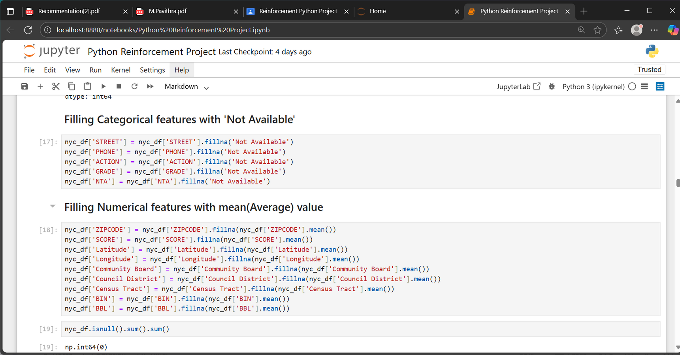
Handling Missing Values
Identified missing values :
Categorical features with “Not Available”.
Filled null values for numerical features with their Average(mean).

Slide 7
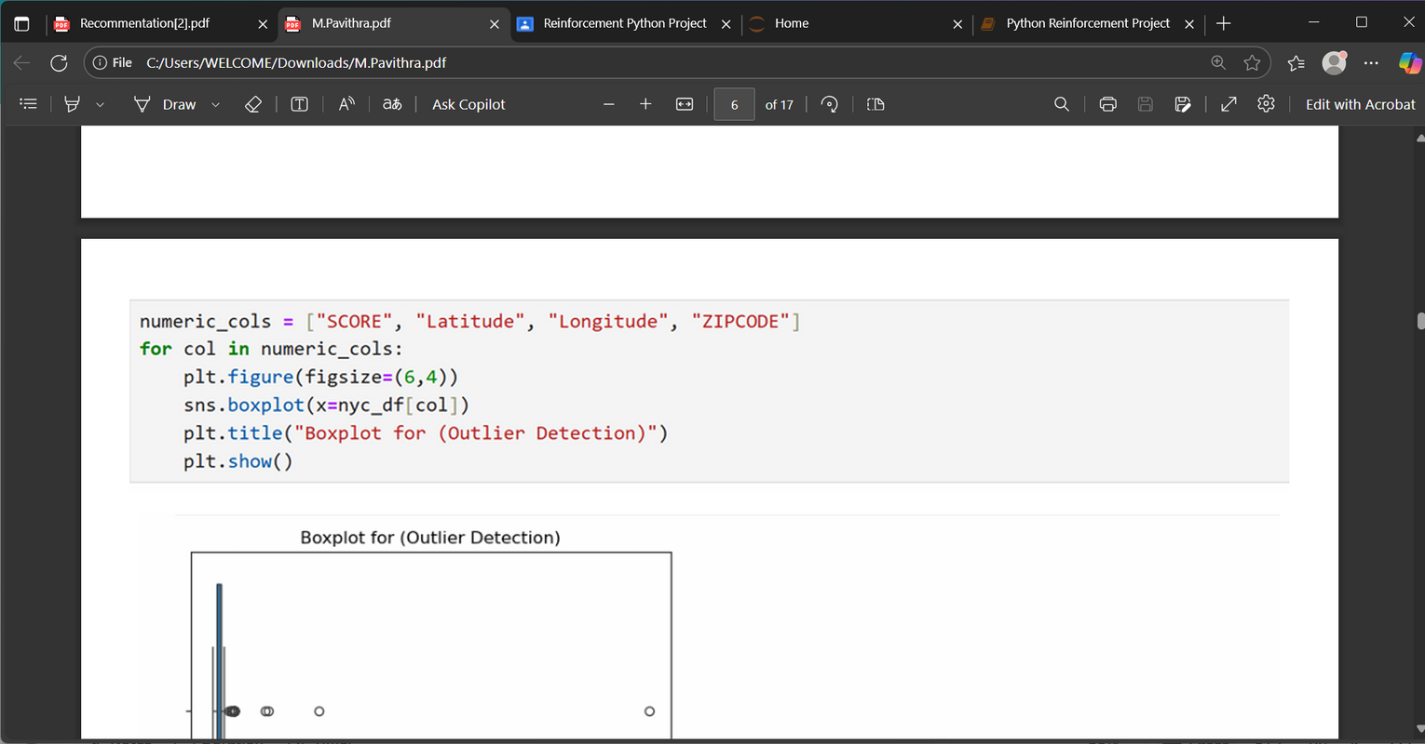
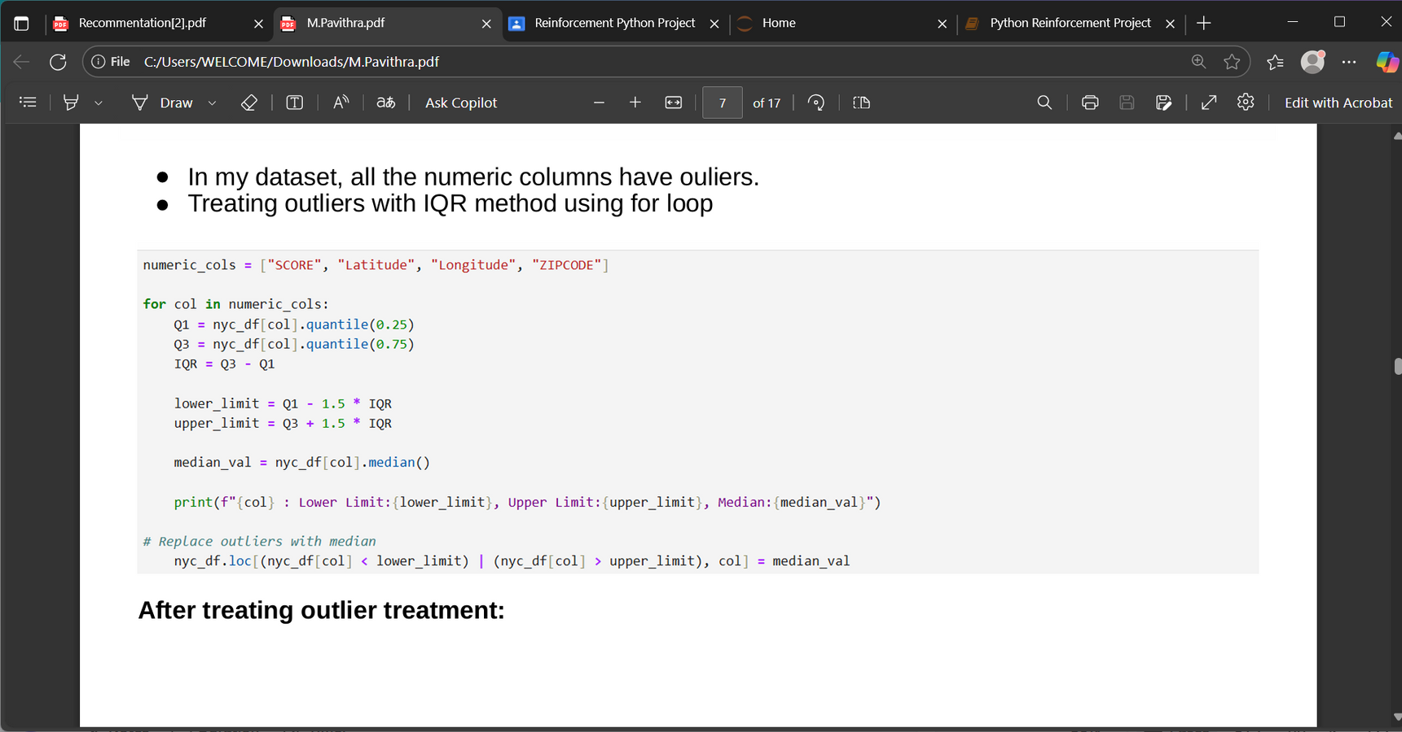
Outlier Handling
Identified outliers using Boxplot method in the numerical columns.
Handled Outliers with Interquartile (IQR) Method.

Slide 8
Handling Invalid Values
Invalid values occur when data is incorrect, inconsistent, or unrealistic. Such values can affect accuracy of the analysis.
Methods Used :
Removing rows
Replacing with appropriate values
Standardizing categories

Slide 9
Statistical Analysis
Performed Statistical analysis to understand relationships between variables in the dataset.
Methods Used :
1.Independent Sample t-test
2.Chi Square Test

Slide 10
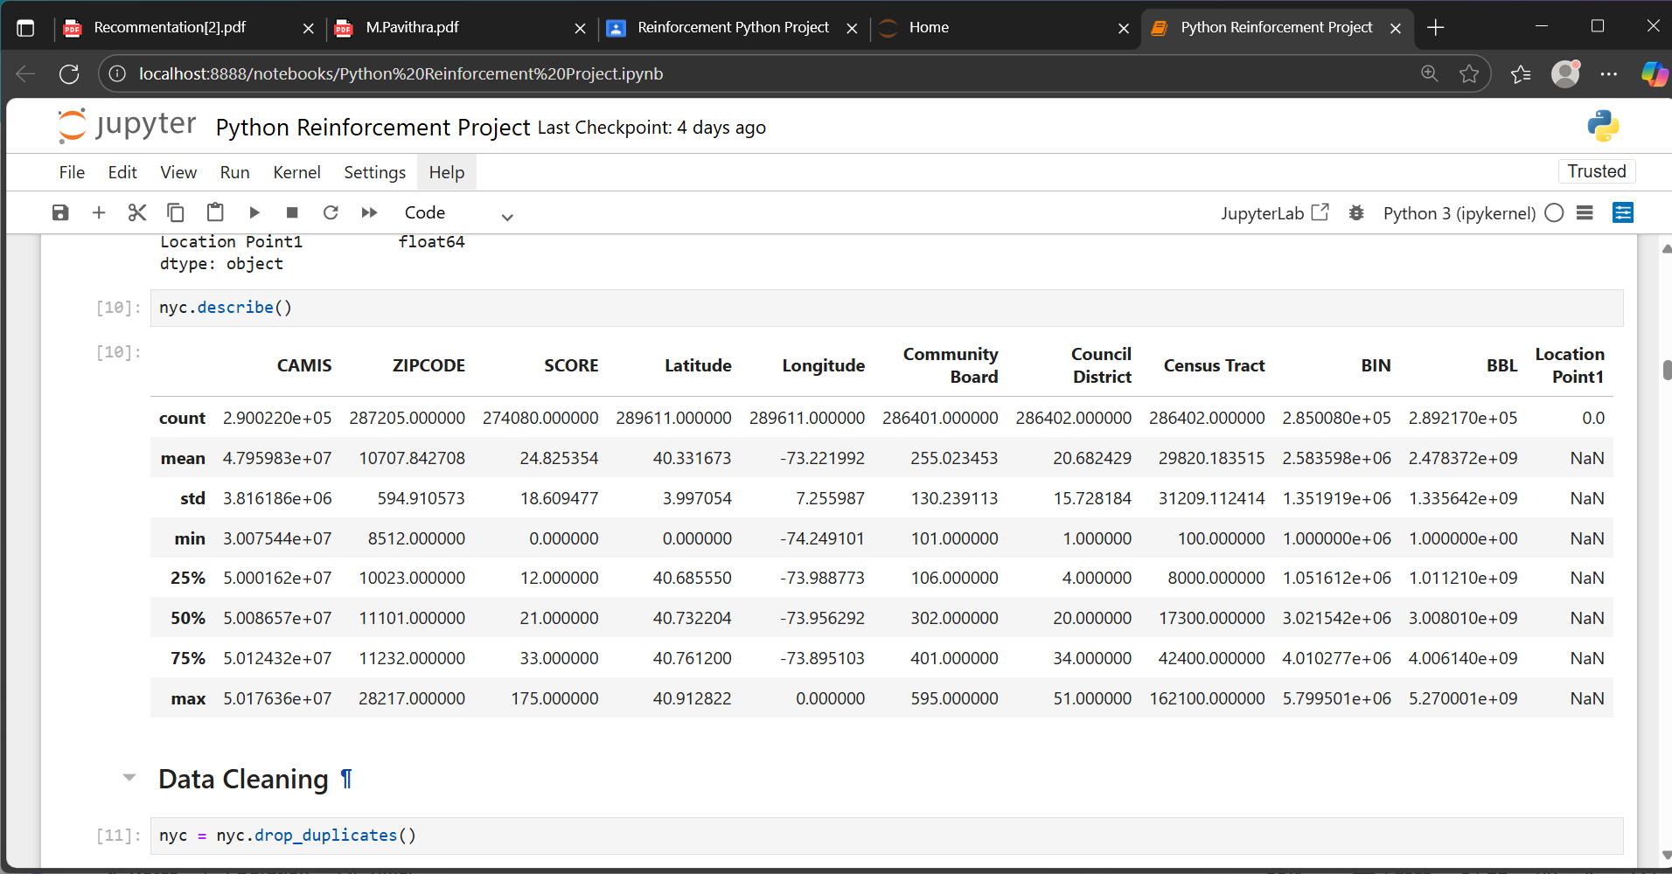
Descriptive Analysis
Descriptive statistics summarize and describe the main features of a dataset.
They include metrics like mean, median, standard deviation, minimum, maximum, and quartiles, which give a snapshot of the distribution and spread of values.

Slide 11
Data Visualization
Importance of Data Visualization
Data visualization helps present complex data in a clear and visual way using charts, graphs, and maps.
It makes information easier to understand, highlights trends and patterns, and supports quick and effective decision-making.
It turns data into meaningful insights that anyone can grasp easily.
Types of Visualizations used :
Histplot
Boxplot
Scatterplot
Barplot
Pairplot
Correlation

Slide 12
Univariate Analysis
Univariate analysis studies one variable at a time to understand its distribution and key statistics like mean, median, and range.
Common techniques include visualizations like histograms, box plots, and bar charts.
It provides a simple yet powerful way to understand each variable’s characteristics before deeper analysis.
Types of Visualizations used :
Numeric Univariate Analysis - SCORE
Used Histplot for visualization
Categorical Analysis - ZIPCODE
Used Boxplot for visualization

Slide 13
Bivariate Analysis
Bivariate analysis is the study of two variables to understand the relationship between them.
It helps determine how one variable influences or relates to another.
Techniques such as scatter plots, correlation analysis, and cross-tabulations are commonly used to visualize and measure these relationships.
Types of Visualizations used :
Numerical vs Numerical - Latitude and SCORE
Used Scatterplot for visualization
Categorical vs Numerical - GRADE and SCORE
Used Barplot for visualization

Slide 14
Multivariate Analysis
Multivariate analysis examines three or more variables simultaneously to understand complex relationships among them.
It helps identify patterns, interactions, and key factors influencing outcomes.
Common techniques include multiple regression, factor analysis, and cluster analysis.
Types of Visualizations used :
Numerical vs Two categorical
SCORE - Numerical , GRADE and ACTION - Categorical
Used Boxplot for visualization
Two Numerical and one Categorical
SCORE and Latitude - Numerical , GRADE - Categorical
Used Pairplot for visualization
Correlation Heatmap
For all Numeric Features.

Slide 15
Conclusion
The project provided valuable insights through data analysis and visualization.By performing EDA, univariate, bivariate, and multivariate analyses, key patterns, trends, and relationships were identified within the dataset.These findings support better decision-making and highlight areas for improvement or further exploration. Overall, the project demonstrates the importance of data-driven approaches in gaining meaningful and actionable insights.
Recommendations
Use key insights from analysis to guide decision-making and strategy development.
Regularly update and monitor the dataset to track changes over time.
Visualize findings clearly to communicate results with stakeholders effectively.

Slide 16
THANK YOU

